Slide 1
Sprint 1
Regression

Slide 2
Sprint 1: Regression
Task: making predictions from data
Core concepts
Algorithms and models
Implementation on real dataset
Assessing a model performance
Overfitting
Bias-variance tradeoff
K-fold cross validation
Simple regression (covered in Statistics sprint)
Gradient descent
Multiple regression
Ridge regression
Lasso regression
Coordinate descent
Wine quality dataset
Boston housing dataset
Sprint 1 - Regression

Slide 3
Sprint 1: Day 1
Task: making predictions from data
Core concepts
Algorithms and models
Implementation on real dataset
Assessing a model performance
Overfitting
Bias-variance tradeoff
Simple regression (covered in Statistics sprint)
Gradient descent
Multiple regression
Wine quality dataset
Sprint 1 - Regression

Slide 4
Sprint 1: Day 2
Task: making predictions from data
Core concepts
Algorithms and models
Implementation on real dataset
Assessing a model performance
Overfitting
Bias-variance tradeoff
K-fold cross validation
Simple regression (covered in Statistics sprint)
Multiple regression
Gradient descent
Polynomial regression
Ridge regression
Lasso regression
Boston housing prices
Sprint 1 - Regression

Slide 5
Implementation: The Boston housing dataset
Sprint 3 - Retrieval

Slide 6

The Boston housing price dataset
Standard dataset preloaded in SciKit Learn. Contains 506 houses from the Boston area and their selling prices.
Input variables
Predictions
Localization characteristics (crime rates…)
House characteristics (nb of rooms…)
Selling price
Sprint 1 - Regression

Slide 7
Algorithm: Polynomial regression
Sprint 3 - Retrieval

Slide 8
From linear regression to polynomial
y
Selling price
x
House size
Sprint 1 - Regression

Slide 9
From linear regression to polynomial
y
Model:
y_{i} = w₀ + w₁ x_{i} + ε_{i}
Selling price
x
House size
Sprint 1 - Regression

Slide 10
Polynomial regression
y
Model:
y_{i} = w₀ + w₁ x_{i} + w₂ x_{i}² + … + w_{D} x_{i}^{D} + ε_{i}
Selling price
x
House size
Sprint 1 - Regression

Slide 11
Polynomial regression
y
Model:
y_{i} = w₀ + w₁ x_{i} + w₂ x_{i}² + … + w_{D} x_{i}^{D} + ε_{i}
Selling price
Treat as different features
(function of the input x)
x
House size
Sprint 1 - Regression

Slide 12
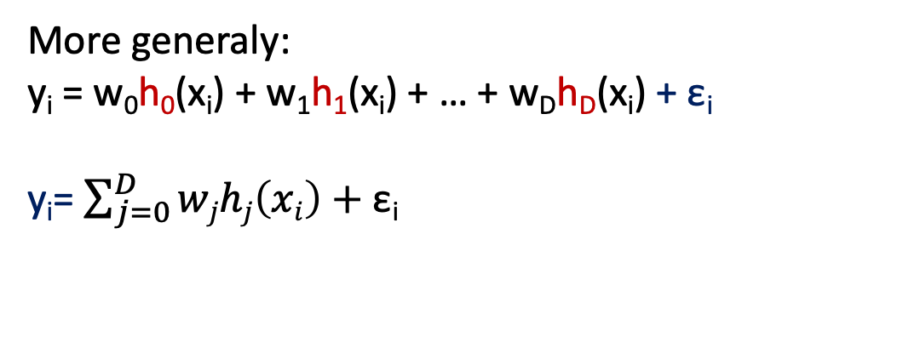
Polynomial regression
y
Model:
y_{i} = w₀ + w₁ x_{i} + w₂ x_{i}² + … + w_{D} x_{i}^{D} + ε_{i}
Selling price
Treat as different features
(function of the input x)
x
House size
In this example :
Feature 1 = 1 (const)
Feature 2 = x
Feature 3 = x²
…
Feature D+1 = x^{D}
More generaly:
y_{i} = w₀h₀(x_{i}) + w₁h₁(x_{i}) + … + w_{D}h_{D}(x_{i}) + ε_{i}
y_{i}= $\sum_{j=0}^{D}{wjhj\left(xi\right)+\text{ε}\text{i}}$
h_{j} = j^{th} feature
W_{j} = weight associated with the j^{th} feature
Sprint 1 - Regression

Slide 13
Machine learning and regression
Training dataset
x
Feature extraction
h(x)
ML model
^
y
Houses
size
polynomial
Predicted
Houses prices
w
ML algorithm
OLS
y
Houses prices
Quality metric
RSS
Sprint 1 - Regression

Slide 14
Implementation: Random polynomial dataset
Sprint 3 - Retrieval

Slide 15
Creating a random polynomial dataset
Create a random polynomial dataset
Fit a linear regression -> Assess its performance
Fit a 2nd degree polynomial model -> Assess its performance
Fit a 4th degree polynomial model -> Assess its performance
Sprint 1 - Regression

Slide 16
Concepts: 3 sources of error and the bias/variance trade-off
Sprint 3 - Retrieval

Slide 17
3 sources of error
In forming predictions, there are 3 sources of error:
Noise
Bias
Variance
Sprint 1 - Regression

Slide 18
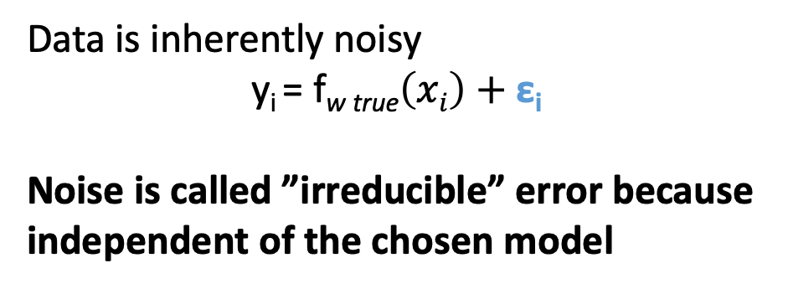
3 sources of error
In forming predictions, there are 3 sources of error:
Noise
Bias
Variance
y
Data is inherently noisy
y_{i} = f_{w true}$\left(xi\right)+\text{ε}\text{i}$
Noise is called ”irreducible” error because independent of the chosen model
price
True fit
House size
x
Sprint 1 - Regression

Slide 19
3 sources of error
In forming predictions, there are 3 sources of error:
Noise
Bias
Variance
y
price
True fit
House size
x
Sprint 1 - Regression

Slide 20
3 sources of error
In forming predictions, there are 3 sources of error:
Noise
Bias
Variance
Bias(x) = f_{w true}(x) – f_{w}(x)
Is the chosen model able to capture f_{w true} ?
If not, there will be a bias is the predictions.
y
price
True fit
Uniform model
House size
x
Sprint 1 - Regression

Slide 21
3 sources of error
In forming predictions, there are 3 sources of error:
Noise
Bias
Variance
Bias(x) = f_{w true}(x) – f_{w}(x)
Is the chosen model able to capture f_{w true} ?
If not, there will be a bias is the predictions.
Linear model
y
price
True fit
Uniform model
House size
x
Sprint 1 - Regression

Slide 22
3 sources of error
In forming predictions, there are 3 sources of error:
Noise
Bias
Variance
Bias(x) = f_{w true}(x) – f_{w}(x)
Linear model
Bias contribution:
assessment of how well the model can fit the relationship between x and y.
y
price
True fit
Uniform model
Low complexity
=
high bias
House size
x
Sprint 1 - Regression

Slide 23
3 sources of error
In forming predictions, there are 3 sources of error:
Noise
Bias
Variance
If we compute model on N different training sets… How much do specific fits vary ?
y
y
y
True fit
x
x
x
Sprint 1 - Regression

Slide 24
3 sources of error
In forming predictions, there are 3 sources of error:
Noise
Bias
Variance
If we compute model on N different training sets… How much do specific fits vary ?
y
y
y
True fit
Uniform model
x
x
x
Sprint 1 - Regression

Slide 25
3 sources of error
In forming predictions, there are 3 sources of error:
Noise
Bias
Variance
If we compute model on N different training sets… How much do specific fits vary ?
Linear model
y
y
y
True fit
x
x
x
Sprint 1 - Regression

Slide 26
3 sources of error
In forming predictions, there are 3 sources of error:
Noise
Bias
Variance
If we compute model on N different training sets… How much do specific fits vary ?
High complexity model
y
y
y
True fit
x
x
x
Sprint 1 - Regression

Slide 27
3 sources of error
In forming predictions, there are 3 sources of error:
Noise
Bias
Variance
High complexity model
Variance contribution:
How much do specific fits vary from the expected fit?
y
True fit
High complexity
=
High variance
x
Sprint 1 - Regression

Slide 28
Bias – variance tradeoff
Variance
There is no way to compute the real bias or variance (we don’t have the true model).
But there are ways to optimize the tradeoff.
Bias
Model complexity
Sprint 1 - Regression

Slide 29
Bias – variance tradeoff
Overfit
Underfit
Variance
Best model possible
There is no way to compute the real bias or variance (we don’t have the true model).
But there are ways to optimize the tradeoff.
Bias
Model complexity
Sprint 1 - Regression

Slide 30
Concepts: Symptoms of overfitting in polynomial regression
Sprint 3 - Retrieval

Slide 31
Overfitting?
Sprint 1 - Regression

Slide 32
Overfitting?
Symptom: Overfit model tends to have large parameters w
Sprint 1 - Regression

Slide 33
Implementation: overfitting on a polynomial regression
Sprint 3 - Retrieval

Slide 34
Creating a random polynomial dataset
Reuse the random polynomial dataset
Fit a 20th degree polynomial model
Re-shuffle the test and training set
Fit the model again (assess the high variance of the model)
Compare the coefficients for linear, 2nd, 4th and 20th degree polynomial fit
Sprint 1 - Regression

Slide 35
Algorithm: Ridge regression
Sprint 3 - Retrieval

Slide 36
Machine learning and regression
Training dataset
x
Feature extraction
h(x)
ML model
^
y
Houses
size
polynomial
Predicted
Houses prices
w
ML algorithm
OLS
y
Houses prices
Quality metric
RSS
Sprint 1 - Regression

Slide 37
Machine learning and regression
Training dataset
x
Feature extraction
h(x)
ML model
^
y
Houses
size
polynomial
Predicted
Houses prices
w
ML algorithm
OLS
y
Houses prices
Quality metric
RSS
Sprint 1 - Regression

Slide 38
Designing a new total cost format
Instead of using simply the RSS to assess the fit, we want to balance:
How well the function fits the data
The magnitude of coefficients
Total cost = measure of fit + measure of magnitude of coefficients
We want to balance
Sprint 1 - Regression

Slide 39
Designing a new total cost format
Instead of using simply the RSS to assess the fit, we want to balance:
How well the function fits the data
The magnitude of coefficients
Total cost = measure of fit + measure of magnitude of coefficients
We want to balance
measure of fit = RSS(w)
Sprint 1 - Regression

Slide 40
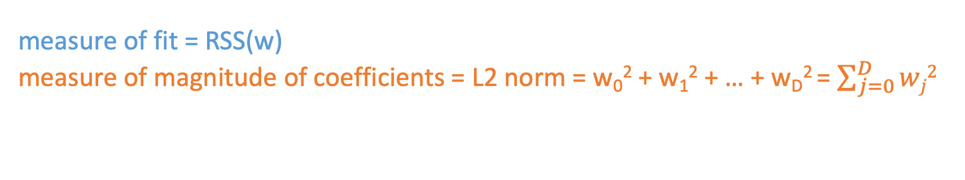
Designing a new total cost format
Instead of using simply the RSS to assess the fit, we want to balance:
How well the function fits the data
The magnitude of coefficients
Total cost = measure of fit + measure of magnitude of coefficients
We want to balance
measure of fit = RSS(w)
measure of magnitude of coefficients = L2 norm = w₀² + w₁² + … + w_{D}² = $\sum_{j=0}^{D}{wj2}$
Sprint 1 - Regression

Slide 41
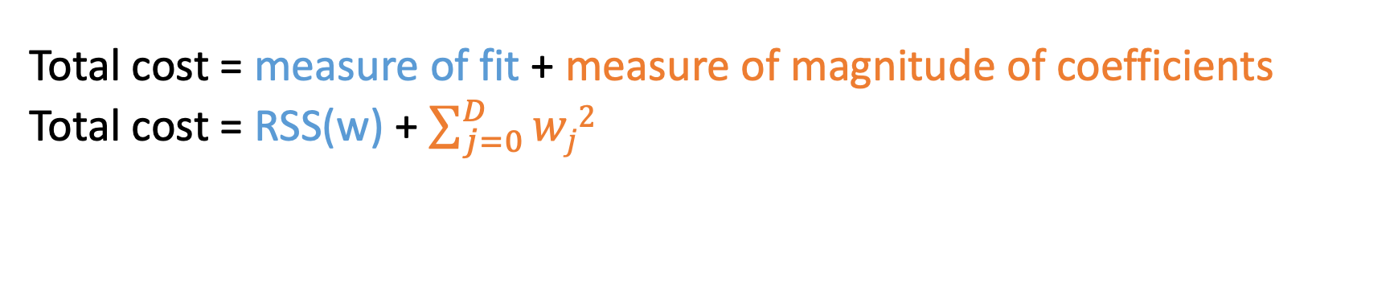
Ridge regression objective
Total cost = measure of fit + measure of magnitude of coefficients
Total cost = RSS(w) + $\sum_{j=0}^{D}{wj2}$
Sprint 1 - Regression

Slide 42
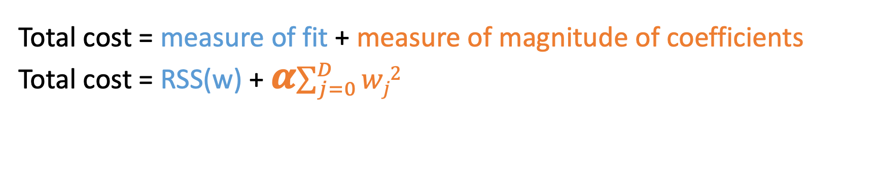
Ridge regression = L₂ regularization
Total cost = measure of fit + measure of magnitude of coefficients
Total cost = RSS(w) + 𝜶$\sum_{j=0}^{D}{wj2}$
Tuning parameter allowing the balance between fit and magnitude
Sprint 1 - Regression

Slide 43
Ridge regression = L₂ regularization
Total cost = measure of fit + measure of magnitude of coefficients
Total cost = RSS(w) + 𝜶$\sum_{j=0}^{D}{wj2}$
If 𝜶 = 0
the objective is to minimize RSS(w) as previously described -> w^{LS}
Sprint 1 - Regression

Slide 44
Ridge regression = L₂ regularization
Total cost = measure of fit + measure of magnitude of coefficients
Total cost = RSS(w) + 𝜶$\sum_{j=0}^{D}{wj2}$
If 𝜶 = 0
the objective is to minimize RSS(w) as previously described -> w^{LS}
If 𝜶 = ∞
For solutions where w = 0, then total cost = ∞
The minimizing solution is w = 0
Sprint 1 - Regression

Slide 45
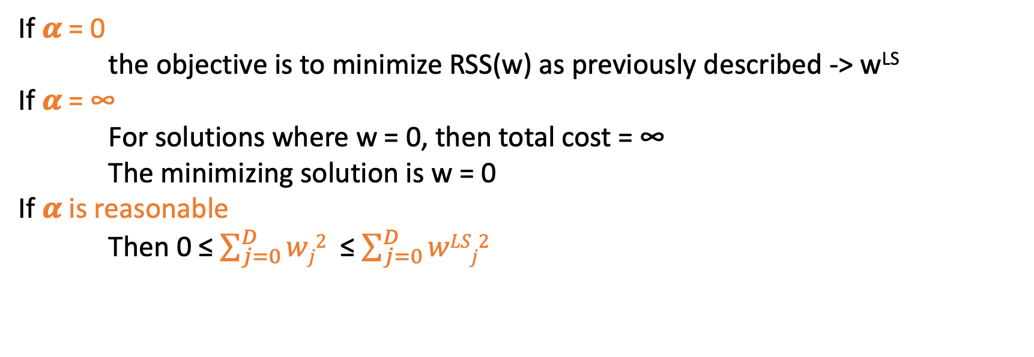
Ridge regression = L₂ regularization
Total cost = measure of fit + measure of magnitude of coefficients
Total cost = RSS(w) + 𝜶$\sum_{j=0}^{D}{wj2}$
If 𝜶 = 0
the objective is to minimize RSS(w) as previously described -> w^{LS}
If 𝜶 = ∞
For solutions where w = 0, then total cost = ∞
The minimizing solution is w = 0
If 𝜶 is reasonable
Then 0 ≤ $\sum_{j=0}^{D}{wj2}$ ≤ $\sum_{j=0}^{D}{wLSj2}$
Sprint 1 - Regression

Slide 46
Bias – variance tradeoff
variance
Large 𝜶
High bias, low variance
e.g w=0 if 𝜶 = ∞
Small 𝜶
Low bias, high variance
e.g just computing RSS(w) when 𝜶 = 0
bias
Sprint 1 - Regression

Slide 47
Implementation: Ridge regression
Sprint 3 - Retrieval

Slide 48
Creating a random polynomial dataset
Reuse the random polynomial dataset
Apply Ridge regularization on the 20th order polynomial fit
Look at the coefficients before and after regularization
Sprint 1 - Regression

Slide 49
Task : feature selection
Sprint 3 - Retrieval

Slide 50
Why feature selections?
Efficiency :
- If size(w) is very large, each prediction is expensive
- If w sparse, the computational cost only depends on the # of non-zero w
Interpretability:
- Which features are relevant for prediction?
Sprint 1 - Regression

Slide 51
Algorithm: Lasso regression
Sprint 3 - Retrieval

Slide 52
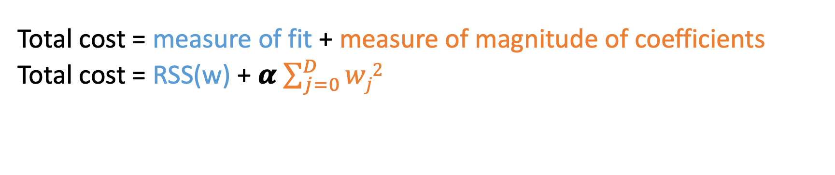
Ridge regression: L₂ regularized regression
Total cost = measure of fit + measure of magnitude of coefficients
Total cost = RSS(w) + 𝜶 $\sum_{j=0}^{D}{wj2}$
Sprint 1 - Regression

Slide 53
Ridge regression: L₂ regularized regression
Total cost = measure of fit + measure of magnitude of coefficients
Total cost = RSS(w) + 𝜶 $\sum_{j=0}^{D}{wj2}$
Encourage small weights w
But not exactly 0 !
w_{j}
Feature 1
Feature 2
Feature 3
Feature 4
Could we use feature regularization to shrink some coefficients to 0 ?
(removing certain features from the model)
0
𝜶
Sprint 1 - Regression

Slide 54
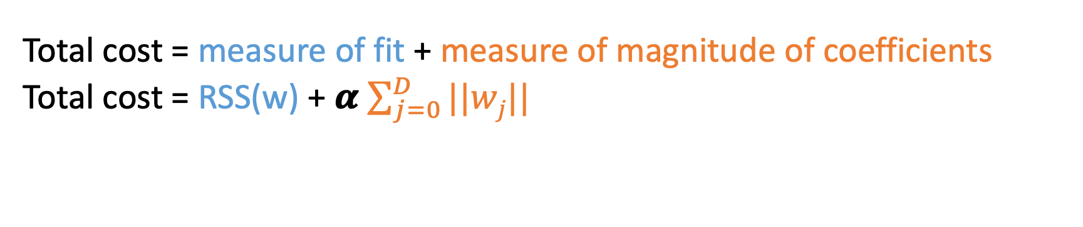
Lasso regression : L₁ regularized regression
Total cost = measure of fit + measure of magnitude of coefficients
Total cost = RSS(w) + 𝜶 $\sum_{j=0}^{D}{||wj||}$
Tuning parameter
Leads to sparse solutions!
Sprint 1 - Regression

Slide 55
Lasso regression : L₁ regularized regression
Total cost = measure of fit + measure of magnitude of coefficients
Total cost = RSS(w) + 𝜶 $\sum_{j=0}^{D}{||wj||}$
Tuning parameter
Leads to sparse solutions!
If 𝜶 = 0
the objective is to minimize RSS(w) as previously described -> w^{LS}
Sprint 1 - Regression

Slide 56
Lasso regression : L₁ regularized regression
Total cost = measure of fit + measure of magnitude of coefficients
Total cost = RSS(w) + 𝜶 $\sum_{j=0}^{D}{||wj||}$
Tuning parameter
Leads to sparse solutions!
If 𝜶 = 0
the objective is to minimize RSS(w) as previously described -> w^{LS}
If 𝜶 = ∞
For solutions where w = 0, then total cost = ∞
The minimizing solution is w = 0
Sprint 1 - Regression

Slide 57
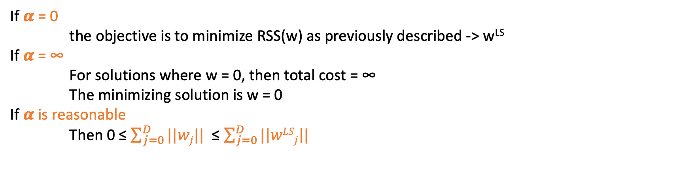
Lasso regression : L₁ regularized regression
Total cost = measure of fit + measure of magnitude of coefficients
Total cost = RSS(w) + 𝜶 $\sum_{j=0}^{D}{||wj||}$
Tuning parameter
Leads to sparse solutions!
If 𝜶 = 0
the objective is to minimize RSS(w) as previously described -> w^{LS}
If 𝜶 = ∞
For solutions where w = 0, then total cost = ∞
The minimizing solution is w = 0
If 𝜶 is reasonable
Then 0 ≤ $\sum_{j=0}^{D}{||wj||}$ ≤ $\sum_{j=0}^{D}{|\left|wLSj\right||}$
Sprint 1 - Regression

Slide 58
Lasso regression : L₁ regularized regression
Ridge regression
w_{j}
Feature 1
Feature 2
Feature 3
Feature 4
0
𝜶
Lasso regression
w_{j}
Feature 1
Feature 2
Feature 3
Feature 4
0
𝜶
Sprint 1 - Regression

Slide 59
Implementation: Lasso implementation
Sprint 3 - Retrieval

Slide 60
Creating a random polynomial dataset
Reuse the random polynomial dataset
Apply Lasso regularization on the 20th order polynomial fit
Look at the coefficients before and after regularization
Create a random dataset and explore the effect of increasing alpha on ridge regression and lasso regression
Sprint 1 - Regression

Slide 61
Concepts: How to choose 𝜶 ?
K-fold cross validation and hyperparameter tuning
Sprint 3 - Retrieval

Slide 62
Up until now:
Training set
Test set
Fit w parameters
Assess generalization error of the model
Sprint 1 - Regression

Slide 63
To tune hyper parameter:
Training set
Validation set
Test set
Fit w parameters
Test performance of the chosen w and select 𝜶
Assess generalization error of the model
Sprint 1 - Regression

Slide 64
To tune hyper parameter:
Training set
Validation set
Test set
Fit w parameters
Test performance of the chosen w and select 𝜶
Assess generalization error of the model
But if the validation set is too small : it won’t give you a good view on the performance !
Sprint 1 - Regression

Slide 65
If not enough data :
Training set
Test set
Preprocessing :
Randomly assign data to K groups
Sprint 1 - Regression

Slide 66
If not enough data :
1
2
3
4
5
Test set
Preprocessing :
Randomly assign data to K groups
Sprint 1 - Regression

Slide 67
If not enough data :
1
2
3
4
5
Test set
1. Choose a 𝜶 = 0.1
Sprint 1 - Regression

Slide 68
If not enough data :
1
2
3
4
5
Test set
1. Choose a 𝜶 = 0.1
2. k = 1
Estimate w ^{(k)} on the training blocks
Sprint 1 - Regression

Slide 69
If not enough data :
1
2
3
4
5
Test set
W⁽¹⁾
1. Choose a 𝜶 = 0.1
2. k = 1
Estimate w ^{(k)} on the training block
Compute error on validation block error_{k}(𝜶)
Sprint 1 - Regression

Slide 70
If not enough data :
1
2
3
4
5
Test set
error₁ (𝜶)
W⁽¹⁾
1. Choose a 𝜶 = 0.1
2. k = 1
Estimate w ^{(k)} on the training block
Compute error on validation block error_{k}(𝜶)
Sprint 1 - Regression

Slide 71
If not enough data :
1
2
3
4
5
Test set
error₂ (𝜶)
W⁽²⁾
1. Choose a 𝜶 = 0.1
2. For k = 1…K
Estimate w ^{(k)} on the training block
Compute error on validation block error_{k}(𝜶)
Sprint 1 - Regression

Slide 72
If not enough data :
1
2
3
4
5
Test set
error₃ (𝜶)
W⁽³⁾
1. Choose a 𝜶 = 0.1
2. For k = 1…K
Estimate w ^{(k)} on the training block
Compute error on validation block error_{k}(𝜶)
Sprint 1 - Regression

Slide 73
If not enough data :
1
2
3
4
5
Test set
error₄ (𝜶)
W⁽⁴⁾
1. Choose a 𝜶 = 0.1
2. For k = 1…K
Estimate w ^{(k)} on the training block
Compute error on validation block error_{k}(𝜶)
Sprint 1 - Regression

Slide 74
If not enough data :
1
2
3
4
5
Test set
error₅ (𝜶)
W⁽⁵⁾
1. Choose a 𝜶 = 0.1
2. For k = 1…K
Estimate w ^{(k)} on the training block
Compute error on validation block error_{k}(𝜶)
Sprint 1 - Regression

Slide 75
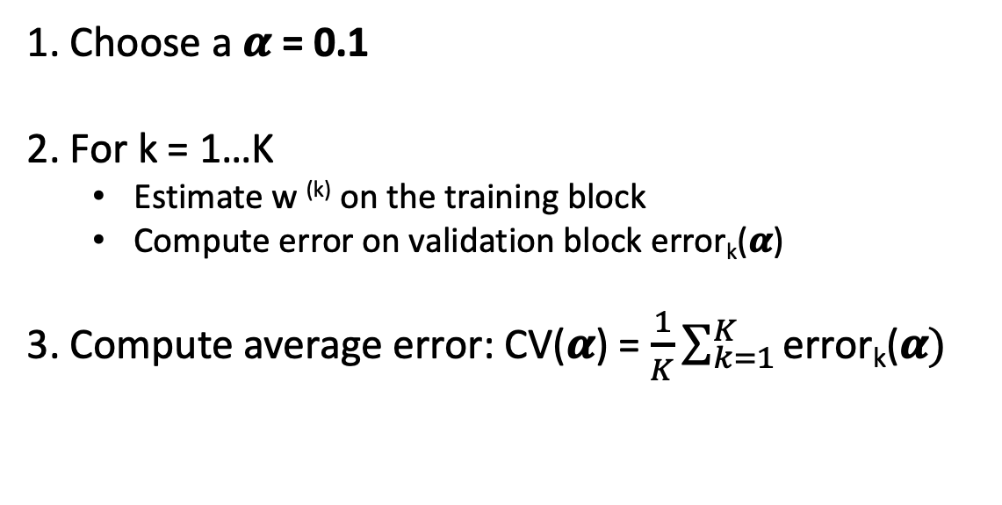
If not enough data :
1
2
3
4
5
Test set
error₅ (𝜶)
W⁽⁵⁾
1. Choose a 𝜶 = 0.1
2. For k = 1…K
Estimate w ^{(k)} on the training block
Compute error on validation block error_{k}(𝜶)
3. Compute average error: CV(𝜶) = $\frac{1}{K}\sum_{k=1}^{K}{\text{error}\text{k}\text{(}\text{α})}$
Sprint 1 - Regression

Slide 76
K-fold cross validation:
1
2
3
4
5
Test set
→ Repeat procedure for each choice of 𝜶
Choose 𝜶 to minimize CV(𝜶)
Formally the best approximation occurs for validation sets of size 1 -> Leave-one-out CV
But computationally intensive !
… Typically people choose k=5 or 10 -> 5-fold CV or 10-fold CV
Sprint 1 - Regression

Slide 77
Implementation: Everything together!
Sprint 3 - Retrieval

Slide 78
The Boston housing price dataset
Standard dataset preloaded in SciKit Learn. Contains 506 houses from the Boston area and their selling prices.
Input variables
Predictions
Localization characteristics (crime rates…)
House characteristics (nb of rooms…)
Selling price
Sprint 1 - Regression

